Slide 1
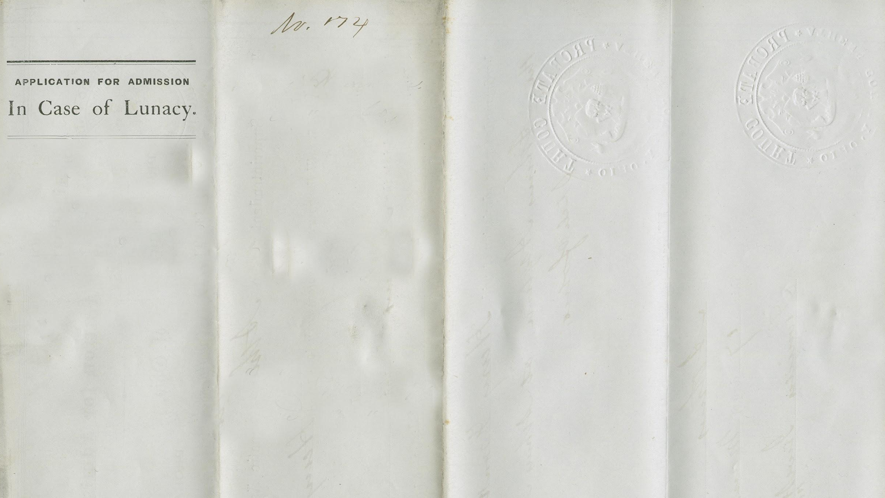
Sparking enthusiasm in freshman psychology majors using the library’s special collections
Paul Campbell and Stacey Lavender
Ohio University Libraries

Slide 2
Overview
  Introductory sessions for first-year psychology majors
  Collaboration between subject librarian and special collections librarian
We’ll cover
  Project goals
  Class design
  Assessment
  Future plans

Slide 3
Why this project?
Paul’s reasons:
UC1900 classes and the problem of creating a meaningful experience without an assignment
Rethink ways of conducting library instruction for classes without assignment
Interested in conducting research on intrinsic motivation
Great opportunity to promote this collection in psychology department
Stacey’s reasons:
Strong student response to this collection in more general sessions
Looking for opportunities to use them in classes where they can be the focus
Opportunity to build relationship with subject librarian and faculty

Slide 4
Class Design

Slide 5
Part 1 - Working with Primary Sources

Slide 6
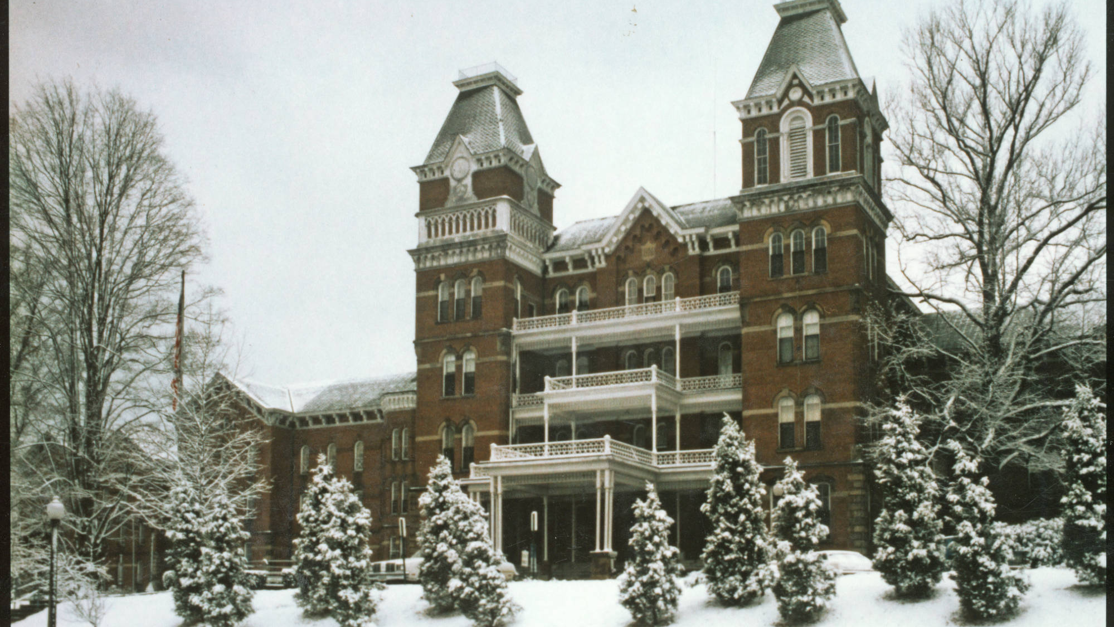
The Place
1874-1993
Buildings and grounds now part of Ohio University
History of strong ties between hospital, campus, and community

Slide 7
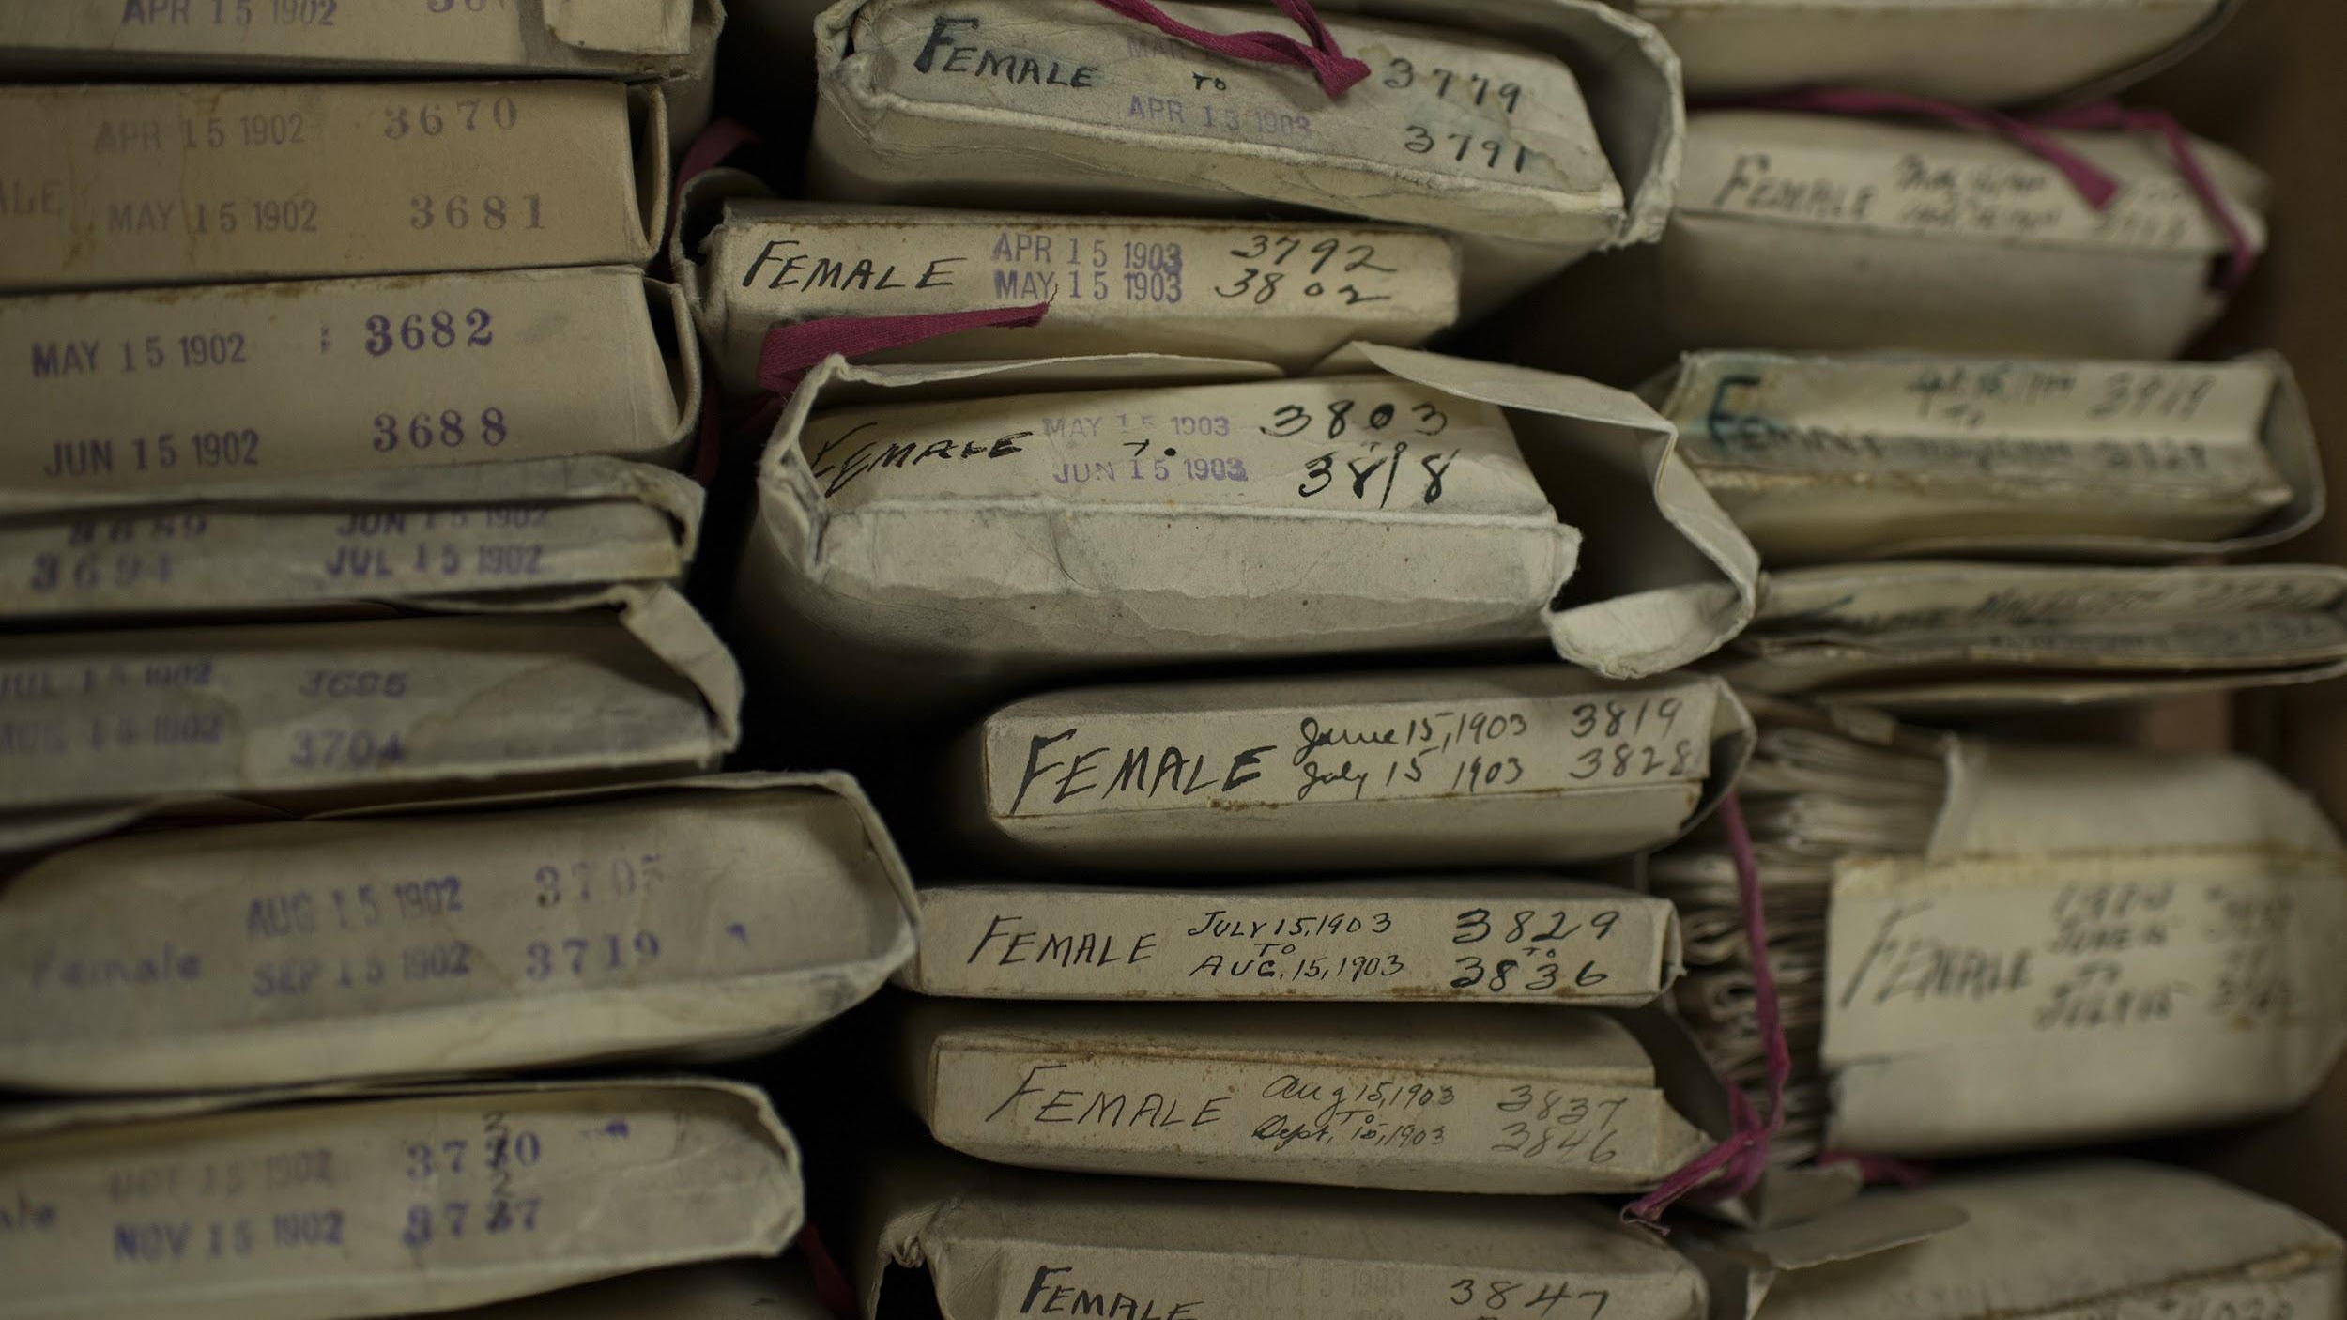
The Documents
Inquest of lunacy records
1874-1911
Closed until 50 years after death

Slide 8
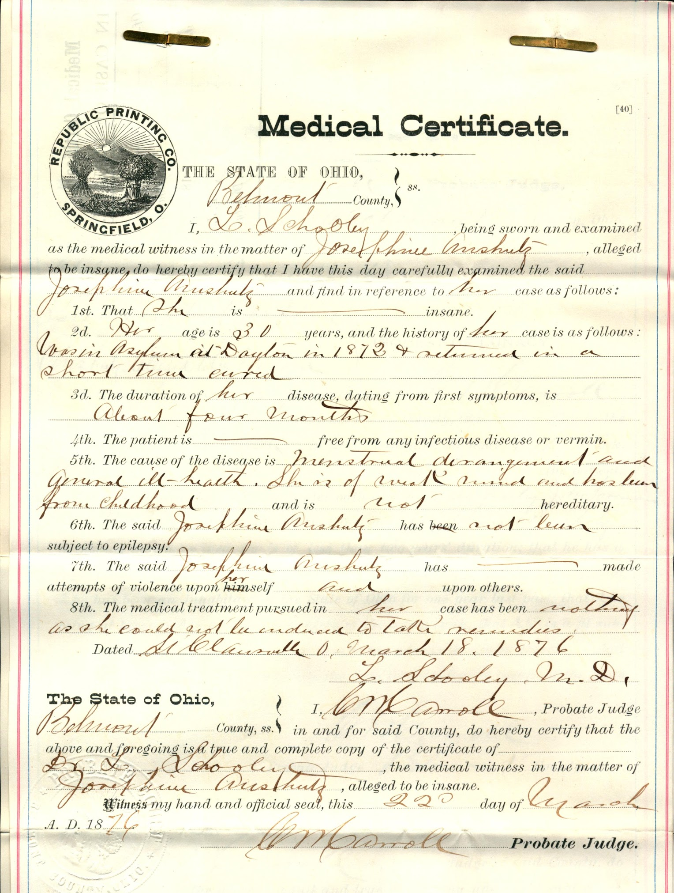
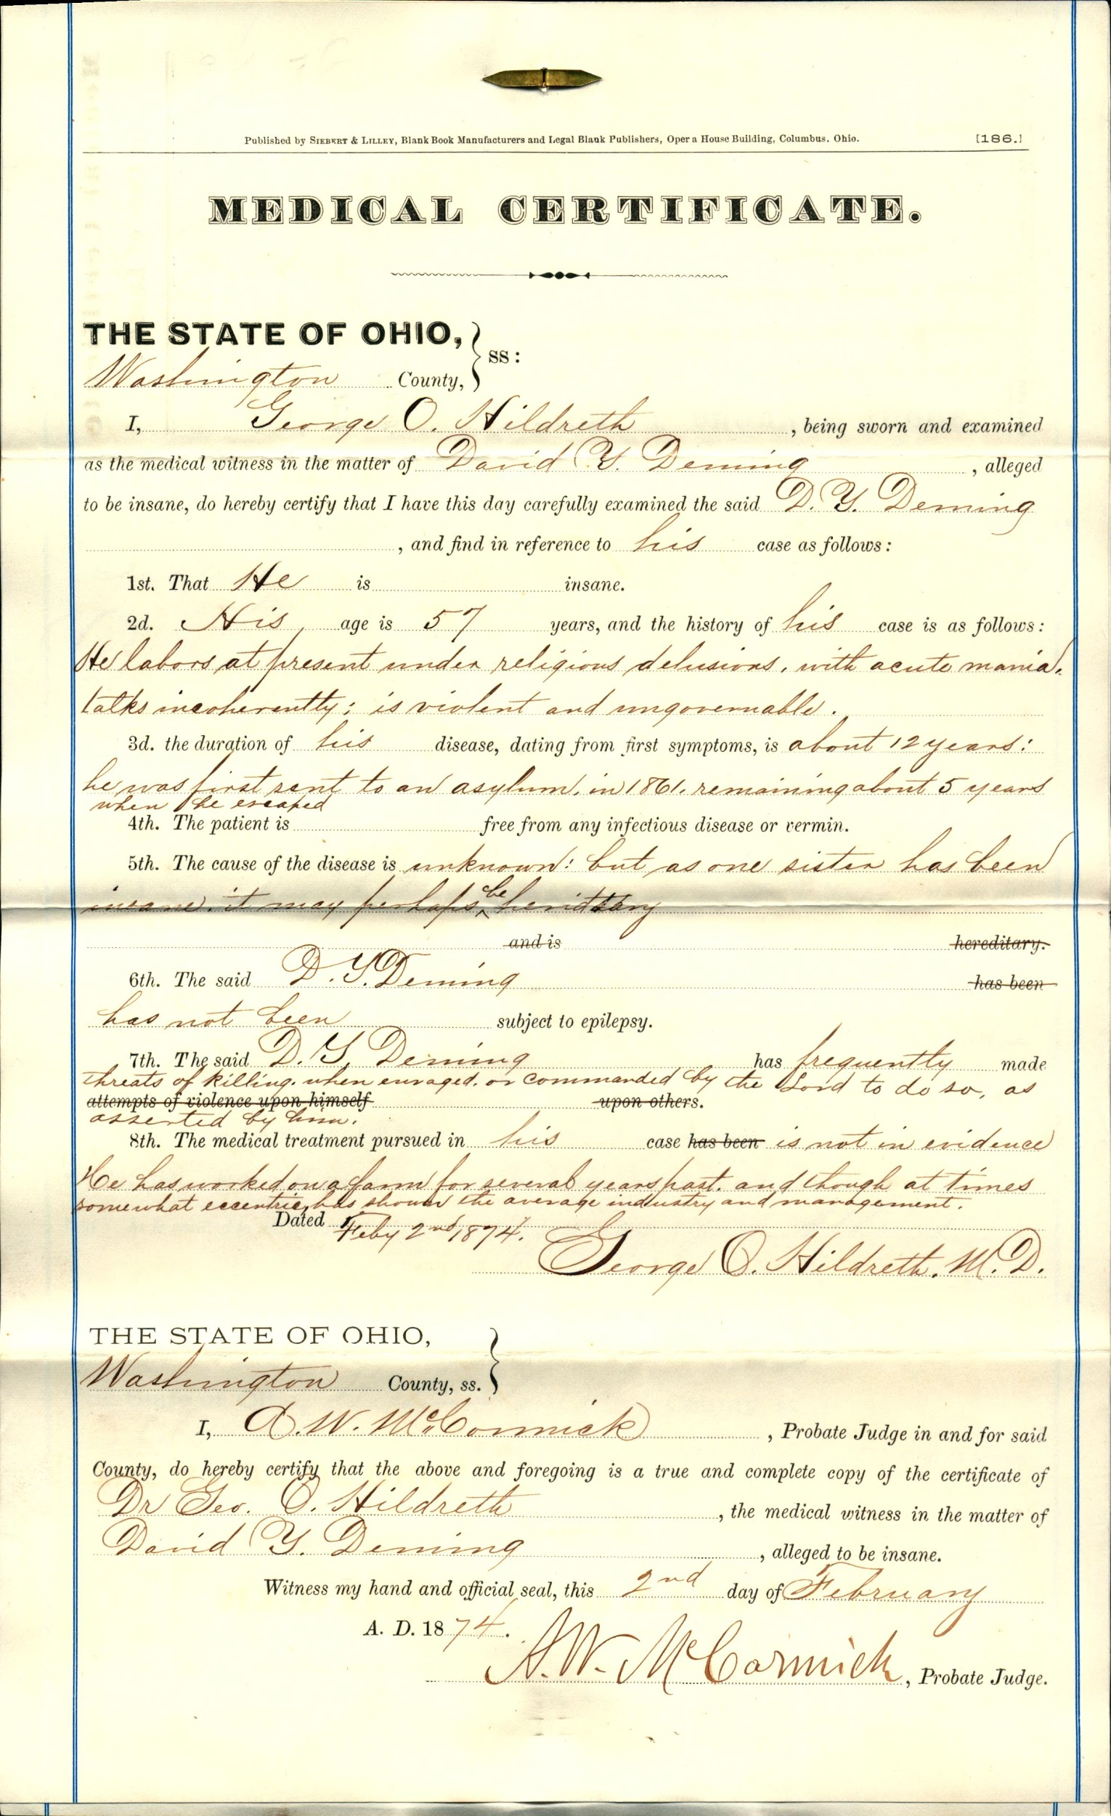

Slide 9
The Activity
Small groups
Document pairs

Slide 11
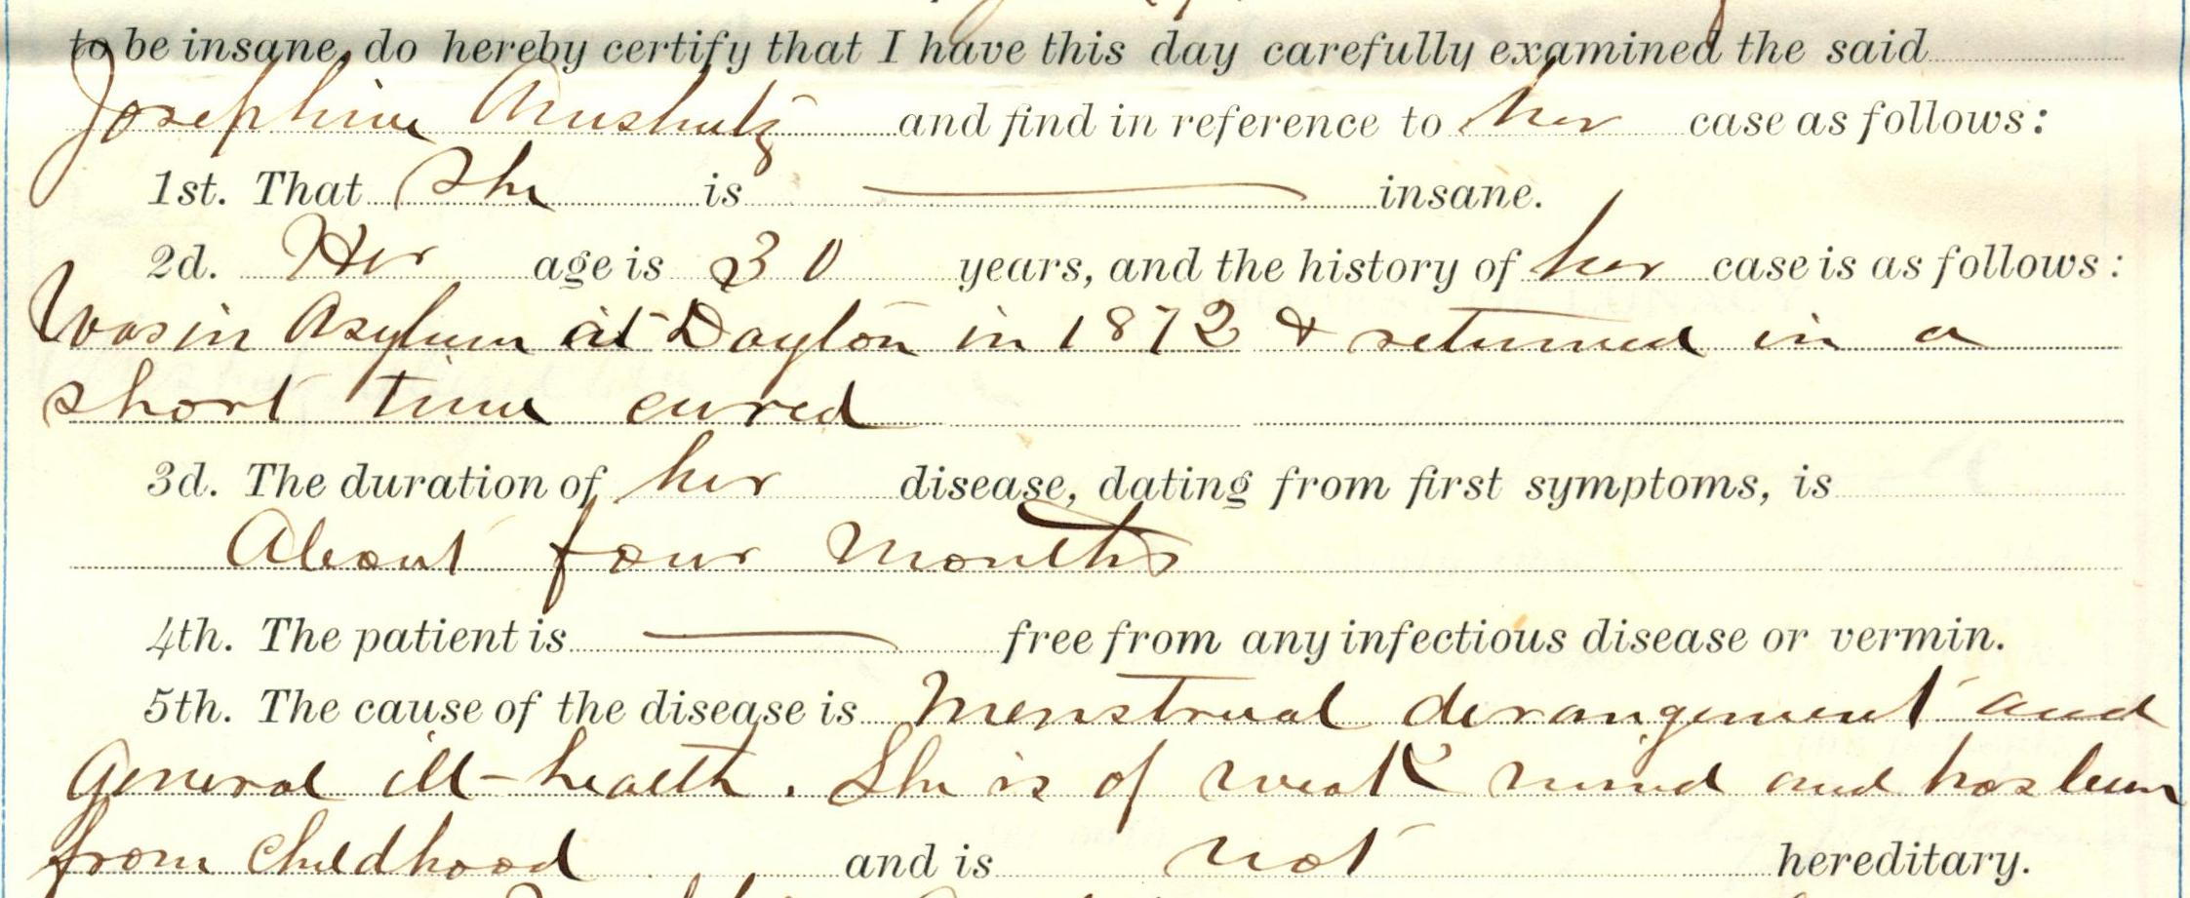

Slide 12
The Activity
Small groups
Document pairs
Worksheet
Discussion

Slide 13
SEE THINK WONDER
SEE: Describe your items. Imagine you are describing them to someone who has never seen them. Include as much detail as possible. Questions you might consider include: Who? What? When? Where?
THINK: Explain what your items may mean, or what makes them important or interesting:
Select the commitment paper that you think most closely describes a recognizable mental illness. How would you describe this person’s illness or symptoms in modern day terms?
For the other commitment paper at your table, what do find particularly strange or interesting about it?
WONDER: What else would you like to know about your items?

Slide 14
Part 2 - Database searching

Slide 15
Searching as Strategic Exploration:
Literature Review discussion
Tied intake forms to keyword generation
Boolean logic in PsycINFO
Discussion on what they found

Slide 16
Assessment

Slide 17
Pre and post test
10 statements using the Likert Scale
Pre- and Post-test
Four sessions
n=33
IRB Approved

Slide 18
Responses

Slide 19
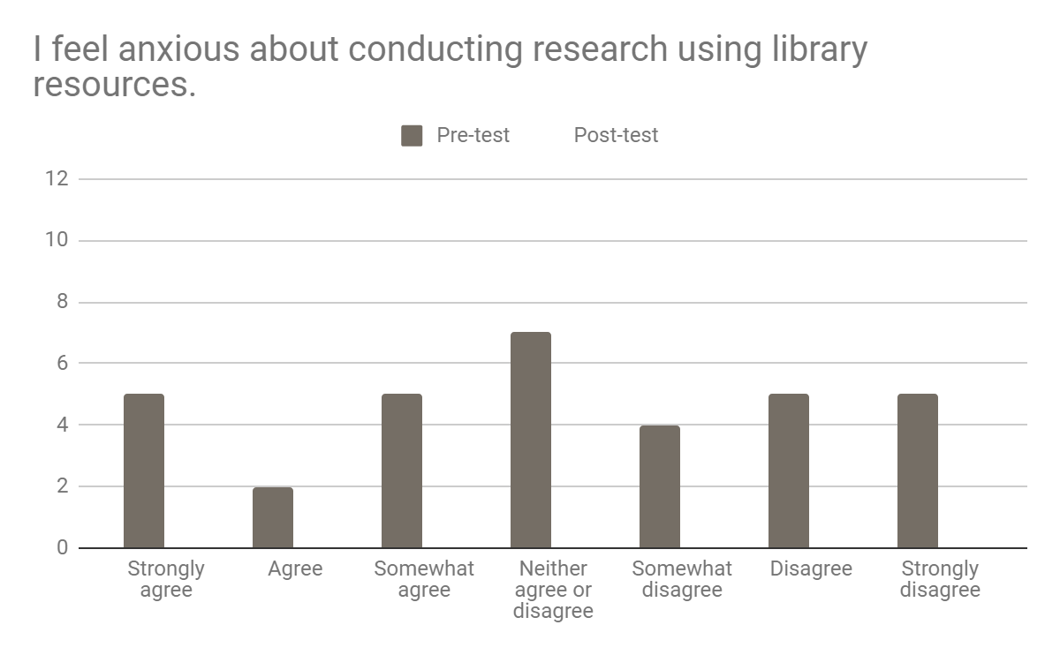

Slide 20
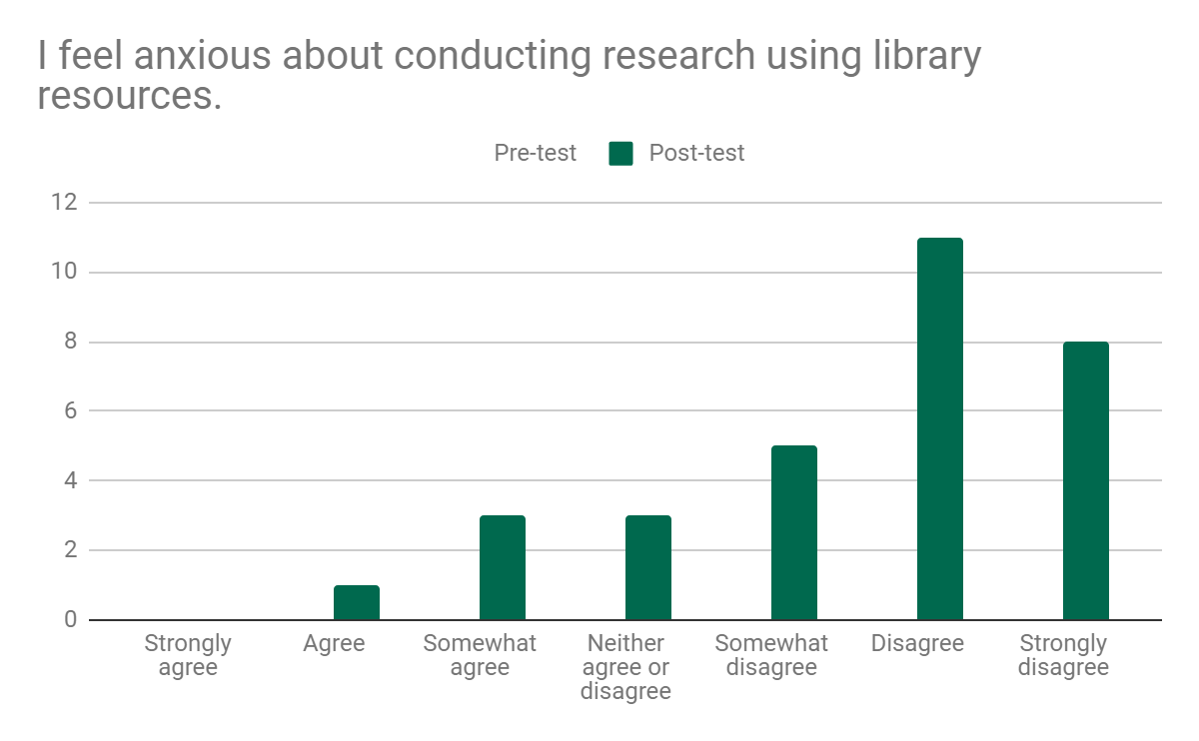

Slide 21
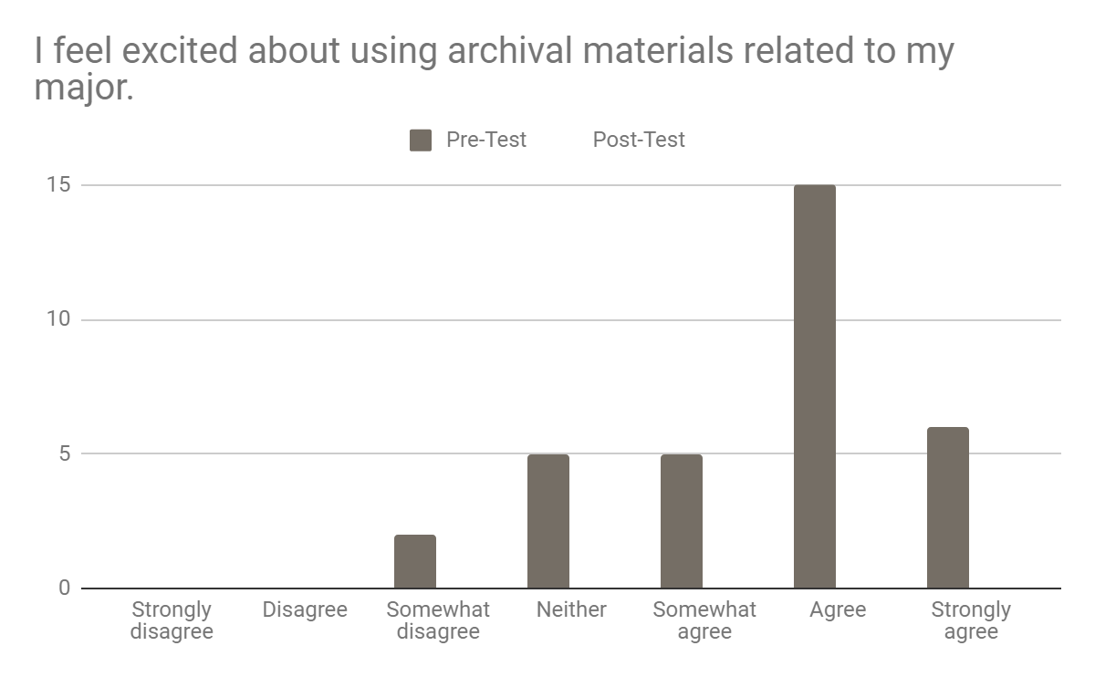

Slide 22
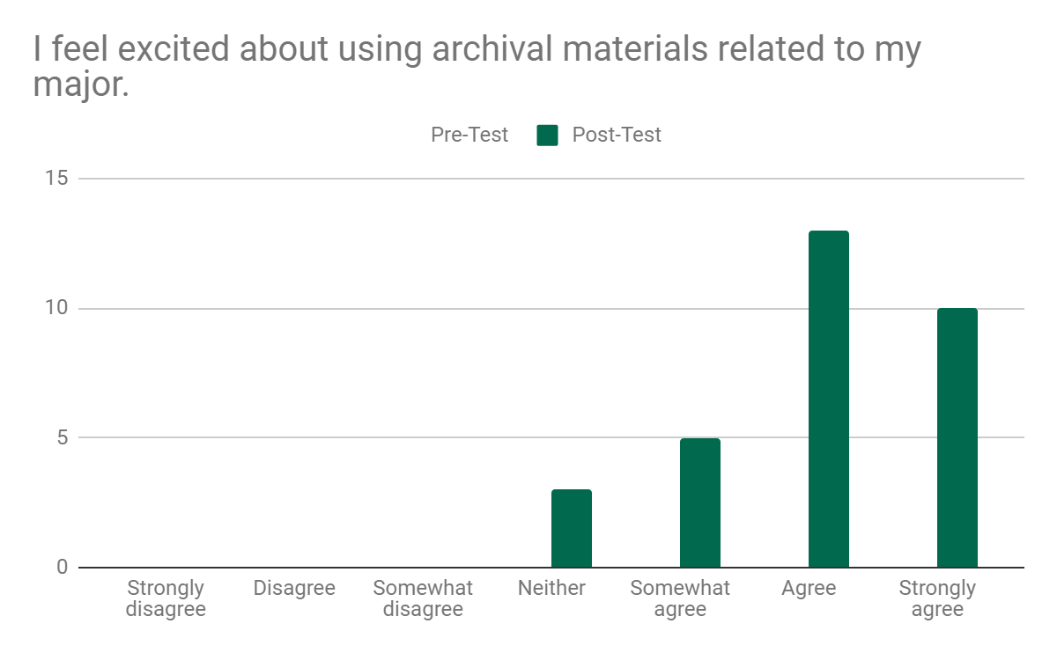

Slide 23
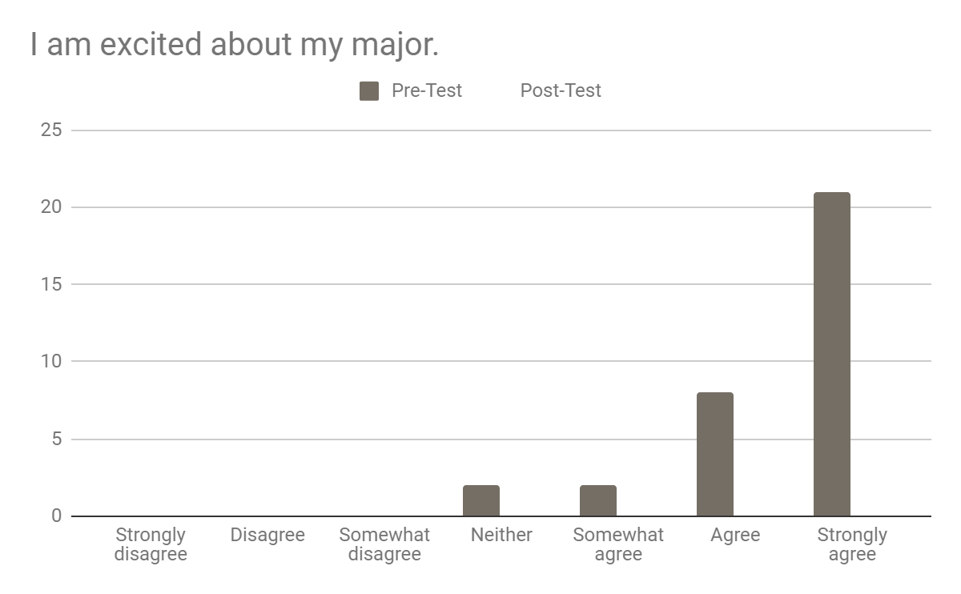

Slide 24
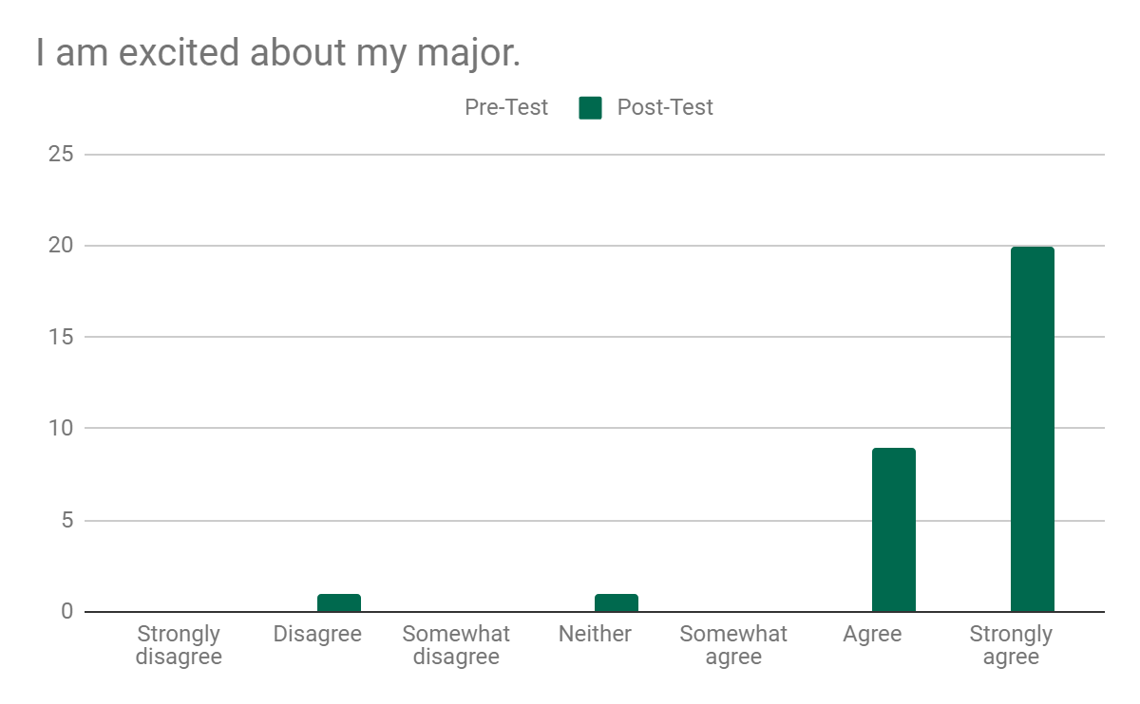

Slide 25
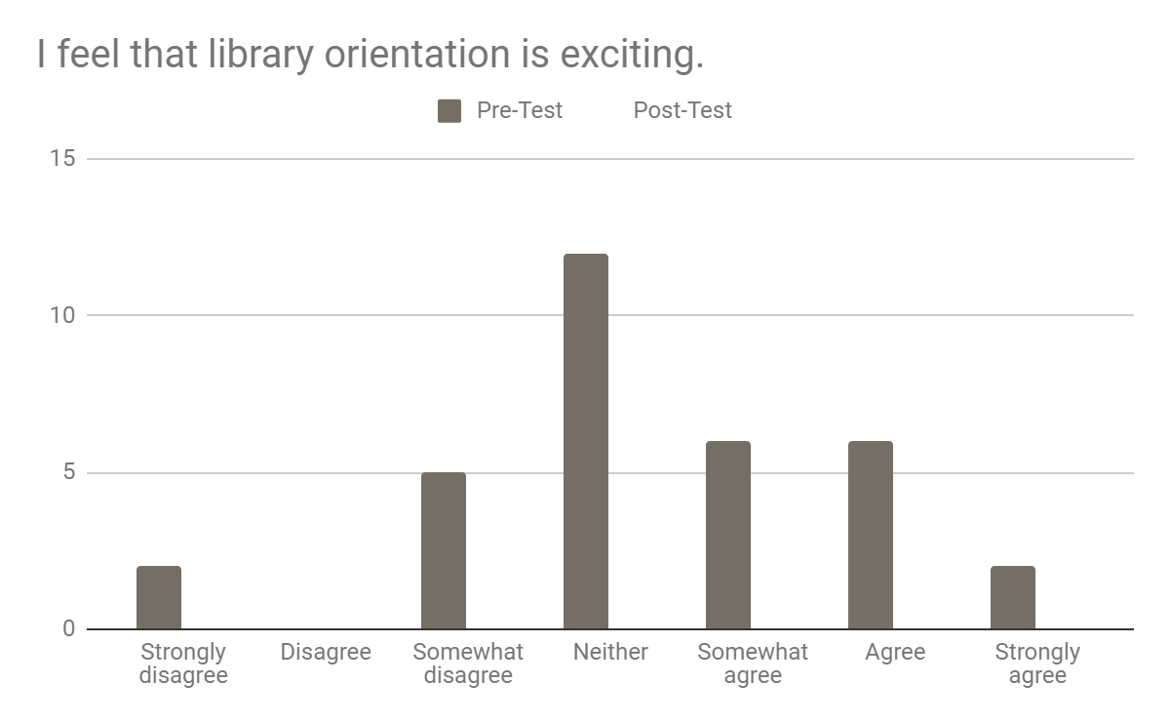

Slide 26
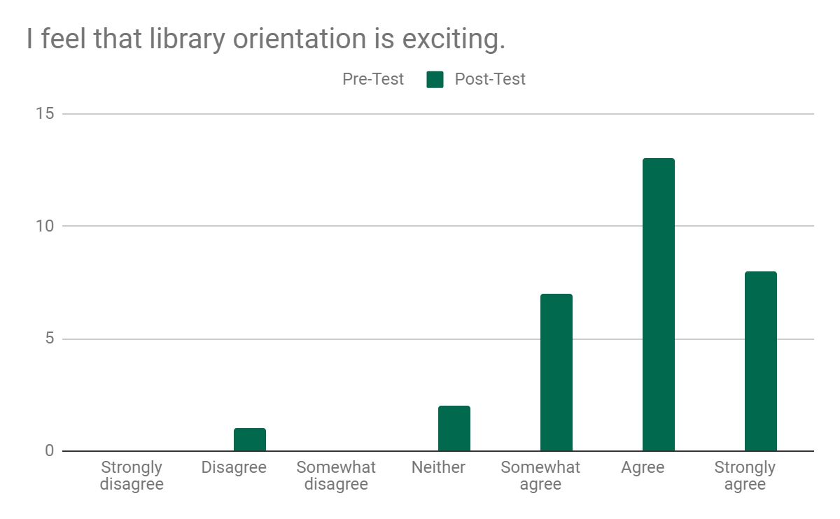

Slide 27
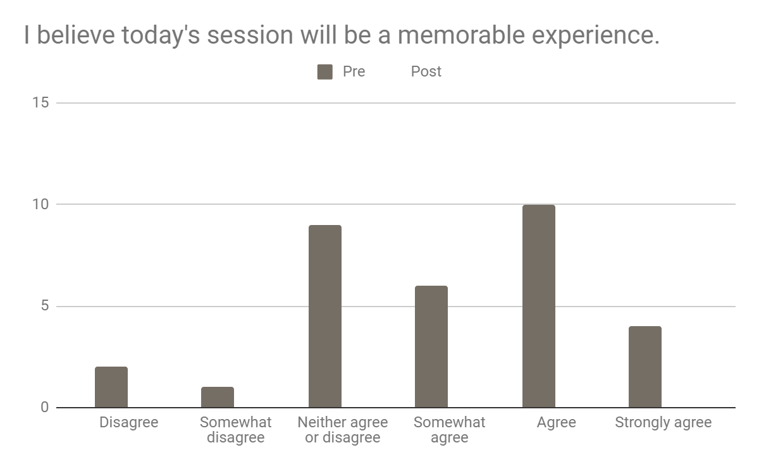

Slide 28
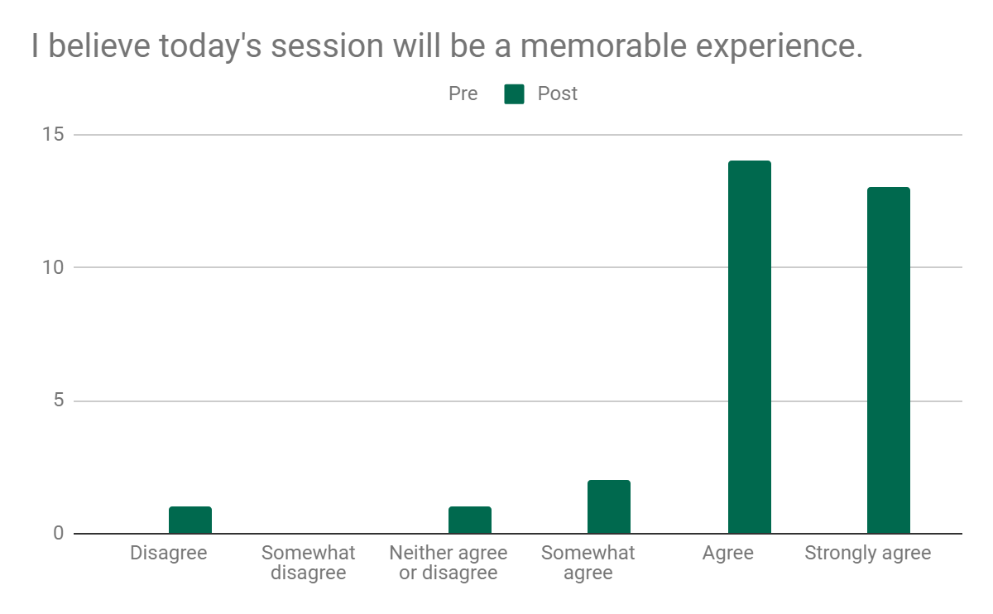

Slide 29
Qualitative Assessment

Slide 30
Did working with these materials have any effect on how you think about psychology as a profession or as a major?
“It just made me more interested”
“I think it made me want to be a psychologist even more”
“Psychology is definitely what I want to do”
“No”

Slide 31
What more would you like to know about the Mahn Center for Archives & Special Collections?
“Is everything up there that cool?”
“...”

Slide 32
Assessment Takeaways
We did see a shift! (In most questions)
Using archives appears to be effective in generating enthusiasm for the major and the library
Helped students clarify or solidify feelings about their major

Slide 33
Study limitations
Small sample size
Students can anticipate the answers we want
We’re not statisticians

Slide 34
Future Assessment Plans
Revisit statements
Make survey and worksheet work together better
How can we use this research to demonstrate the library’s value?

Slide 35
Future Class Plans
Keep doing them
Change up the pairings
Revisit activity
Transcripts?

Slide 36
Think-Pair-Share
How would you conduct assessment for an activity designed to increase motivation or enthusiasm?

Slide 37
Thanks!
Paul Campbell campbep1@ohio.edu
Stacey Lavender lavendes@ohio.edu

